Slide 1
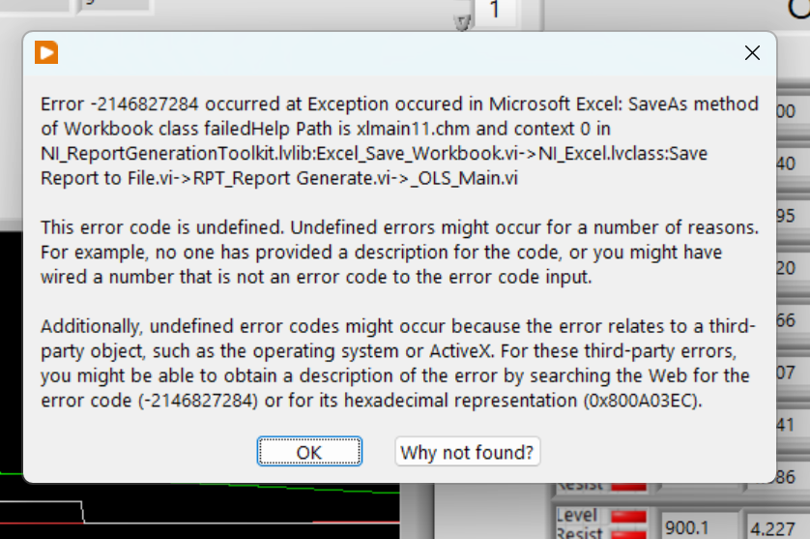

Slide 2
Undefined Error Codes
Undefined errors can occur for many possible reasons. The following are some suggestions and ideas for ways to identify and handle undefined errors.
Undefined errors might occur if a description does not exist for the error code. You can create and define a custom error code yourself. You also can contact National Instruments technical support for assistance with undefined error codes.
An undefined error might occur if you wire a number that is not an error code to an error code input.
Undefined error codes might occur because the error relates to a third-party object, such as the operating system or ActiveX. For third-party errors, you can search the Web for a description of the undefined error code. You can search with the numerical error code or for the hexadecimal, or hex, representation of the code. For example, you can search for the error code 12341234 or for the hex display of the code, 0xBEEDF00F.
TipActiveX error codes are documented by Microsoft in winerror.h.
Applications or Shared Libraries
If you are developing an application or shared library, you must distribute any relevant error code text files with the application or shared library.
Legacy or Third-Party Drivers

Slide 3
